Slide 1




Signless
Alex Bogdanov, Enzo Carvalho, Oscar Arana
Real time audio to sign language translation

Slide 2
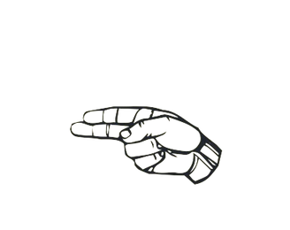
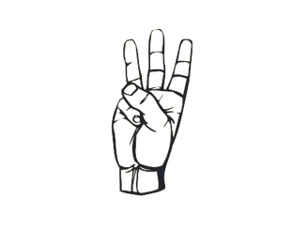
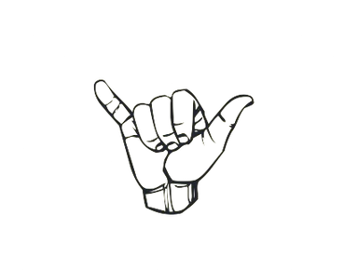
(Why)
No widespread application in the market for ASL
Not enough awareness/support
Inclusivity, breaking down communication barriers

Slide 3

(How)
By integrating OpenAI’s Whisper model with our application
Audio to Text Text to Sign Language

Slide 4


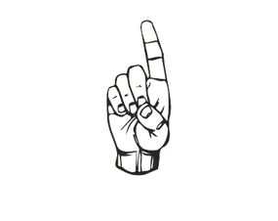
(Demo)

Slide 5

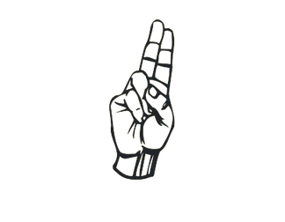
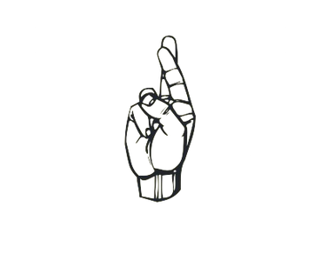

Future Implications
Multiple sign languages (SLE, Libras)
Video and image text and audio
Complete words

Slide 6

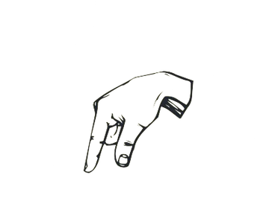


Questions?

Slide 7

Thank you!

Slide 8
References
OpenAI’s API documentation
American Sign Language translator
NodeJS, React Native, Expo, Express

